Slide 1
Lecture 3, Sections 3-4
Computational Chemistry

Slide 2
Lecture 3 Contents
The Many Electron Problem
The Hartree Model
Pauli Principle
Slater Determinants
Hartree-Fock Model
Hartree-Fock-Slater Model
Numerical Methods for Implementation

Slide 3
Problem with the Hartree Model
Electrons are assigned unique spatial-orbitals
Spin not accounted for in the Hartree Model
Consequences:
Electrons treated as being distinguishable (Not a Fermion property)
The atomic wavefunction becomes symmetric. (Violation of the Pauli exclusion principle)

Slide 4
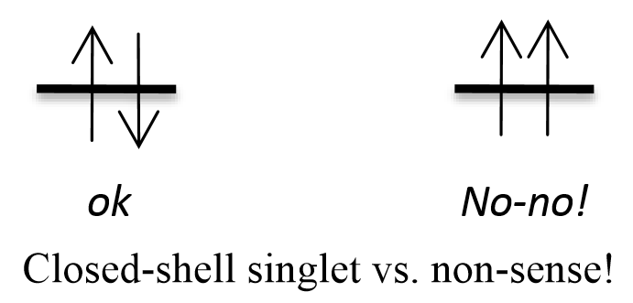

Pauli Principle
One of the fundamental postulates of QM:
By accounting for electron spin, we see a different wave function symmetrization than that of the Hartree Model.

Slide 5
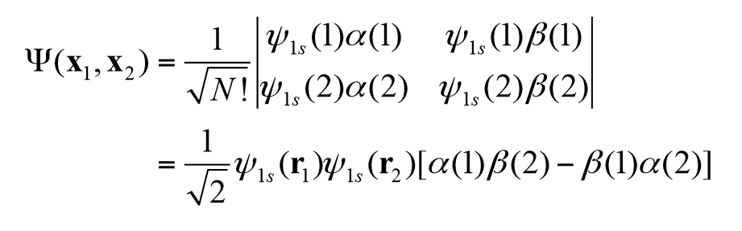
Slater Determinants
To combine spin-orbitals in a way which satisfies the Pauli Principle, we can use Slater Determinants:
The Slater determinant results in anti-symmetric wave functions.

Slide 6
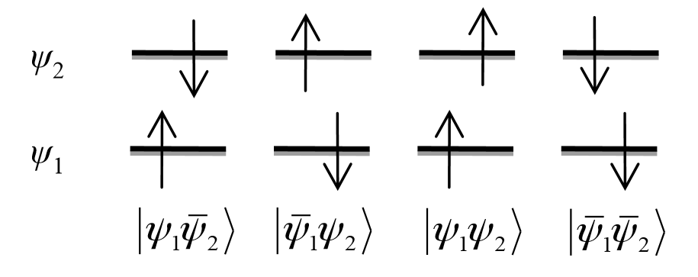
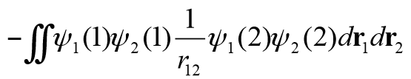
Exchange Force
Interaction energies differ between electrons with different spin states.
Expectation value of interaction energy differs by:
1 2 3 4
Exchange Integral
The interaction energy is lower between electrons of the same spin. The difference in energy is due to the exchange force.
E₃ and E₄ < E₁ and E₂

Slide 7
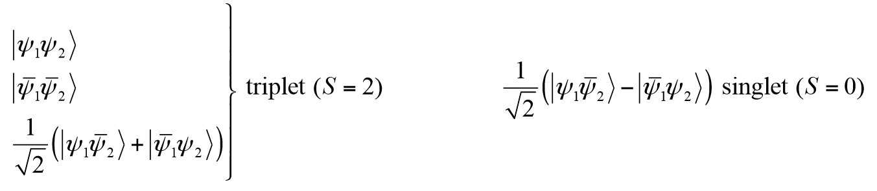
Spin-State Differences
1 2 3 4
Electronic degeneracy given by the equation Mult = 2S + 1.
S = 0 corresponds to one energy state.
S = 1 corresponds to a triplet of spin energy states.
1?

